Slide 1

MOVIE SALES ANALYSIS
Team Members and roles:
Arasu Ragupathi
Ken Biju Jacob
Nithish H Prabagaran

Slide 2
Introduction
Objective: What is the goal of the project?
To analyze movie data from sources like Box Office Mojo, IMDB, TMDB.
To identify trends in profitability and popularity of movies over the last decade.
To provide insights for ABC's strategy as they plan to enter the movie market.
Key Question: The main question your analysis aims to answer
What types of movies have been the most successful in the last decade?
From a profitability perspective (e.g., revenue vs. budget).
From a popularity perspective (e.g., ratings, reviews, and audience engagement).

Slide 3
Why It Matters: Briefly explain the significance of your project. Why It Matters: Briefly explain the significance of your project.
Helps the production house to identify the right opportunities and minimize risks in the competitive movie industry.
Provides a data-driven strategy for ABC’s movie market entry, ensuring their investments align with trends.
Enables understanding of audience preferences, ensuring successful content creation.

Slide 4
.
The goals and objectives
Analyze the types of movies that have been most successful over the past decade.
Identify trends in genre, budget, revenue, and popularity metrics.
Develop a data-backed strategy to help our production house navigate the competitive movie industry.

Slide 5
Problem Statement
With our production house planning to enter the movie market, they face challenges in identifying the right types of movies to produce or invest in. The problem lies in determining:
What makes a movie successful?
How to balance profitability with popularity to ensure sustained growth and audience engagement.

Slide 6
Dataset Overview
Dataset Name and Source
The dataset used for this analysis combines data from Kaggle, Box office mojo,The Movie Database (TMDB).

Slide 7
Key features:
TMDB Dataset
Contains around 27,576 movies released between 1930 and 2020.
Includes variables such as genre, popularity, vote average, vote count, and release date.
Movie Budget Dataset
Includes data for approximately 5,800 movies released between 1915 and 2020.
Contains variables for domestic gross revenues, worldwide gross revenues, production budget, and release date.
Final Combined Dataset
Created by linking genre and review data from TMDB with budget and revenue data.
Includes 1760 rows, spanning the years 1946 to 2019.
The analysis focuses primarily on movies released on or after 2010 with medium to very high budgets.

Slide 8
Data Preparation
Data cleaning
Handling Missing Values
Genre Splitting
New Metrics and Categories
Outlier Management
Tools & techniques used
Python: matplotlib, seaborn, pandas and numpy
Power BI: Data transformation with Power Query.
SQL server management studio: Merging keys, joining data.

Slide 9
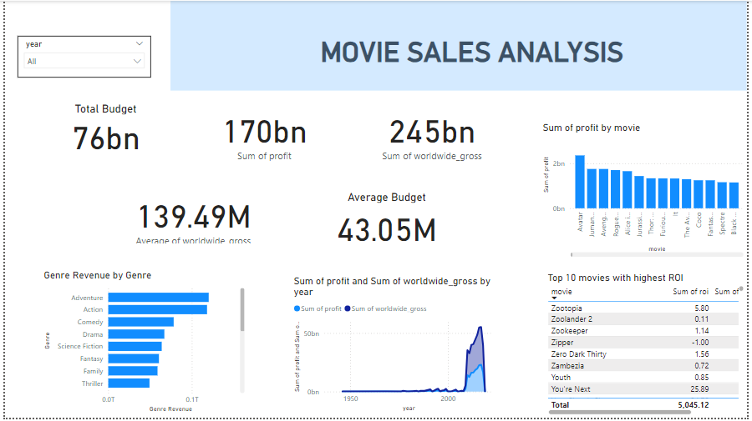
Dashboard

Slide 10
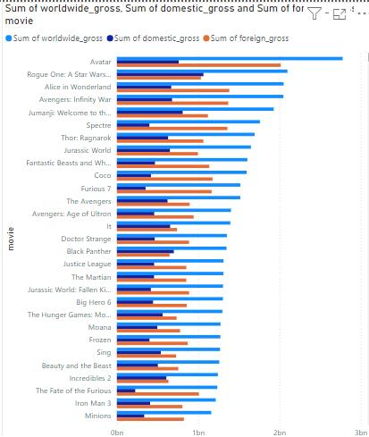
Worldwide Gross

Slide 11
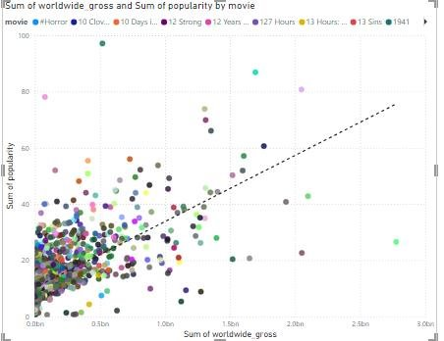
Positive Correlation

Slide 12
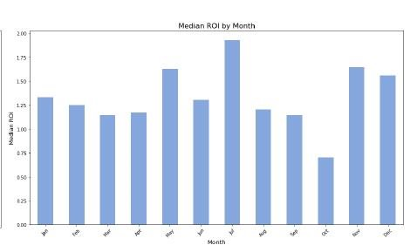
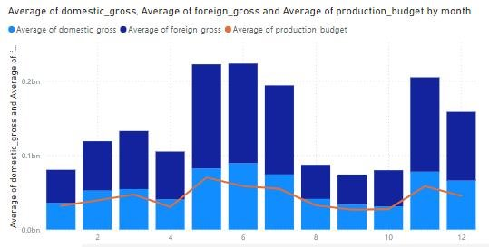
Capitalize on Summer and Winter Holidays

Slide 13
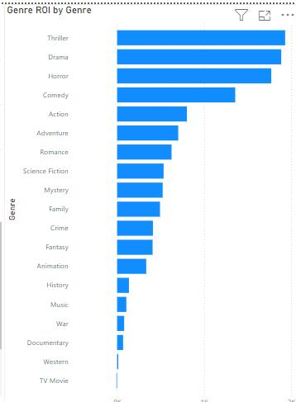
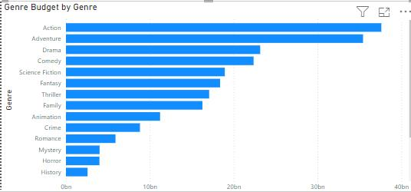
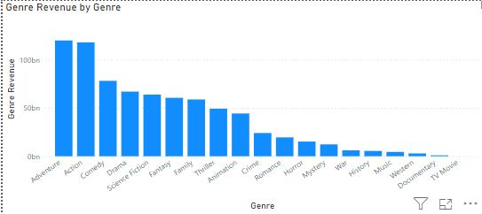
Genre Analysis

Slide 14
Analysis and Findings
Summarized Key Findings
Popularity vs. Revenue: Higher popularity generally correlates with higher revenue, but outliers suggest quality also plays a role.
Top-Grossing Genres: Adventure, action, and Comedy generate the highest revenue. Animation provides the best ROI, while horror excels in low-budget success.
Seasonal Impact: Summer and winter releases yield the highest revenues.

Slide 15
Patterns and Trends
Budget vs. Ratings: Popularity increases with budget, but vote ratings are independent of budget, highlighting the role of quality.
Genre Success: Romance and family movies perform well when considering both returns and popularity, even outperforming horror in some aspects.
Studio Strategy: Diversifying genres and budgets is a successful approach for studios.

Slide 16
Surprising Results
Budget Independence: Voted ratings are not budget-dependent, suggesting other factors like storytelling and talent impact audience reception.
Regional Data Gaps: Lack of geographical revenue data limits insights into regional profitability.

Slide 17
Challenges and Limitations
Data Issues: Missing or inconsistent values, especially for older movies.
Dataset Scope: Focused mainly on post-2010 medium to high-budget films.
Lack of Factors: Excluded key variables like marketing, runtime, or director quality.
Geographical Insights: Missing geographical revenue data to identify high-ROI regions for targeted releases.

Slide 18
Recommendations and Insights (Answer to problem statement)
Actionable Insights
Release Timing: Focus on releasing movies in summer or winter for maximum revenue.
Genre Strategy: Invest in animation, adventure, and sci-fi for high ROI. For lower budgets, target horror movies.
Diversification: Produce movies across a variety of genres and budget ranges to balance risk and ensure consistent profitability.

Slide 19
Conclusion
Movies with higher popularity and blockbuster budgets perform best, but low-budget horror movies yield strong ROI.
Adventure, animation, and action dominate in revenue, while strategic timing enhances success.
Successful studios diversify across genres and budgets.
Significance:
These findings can guide our production house entry into the movie industry by identifying profitable strategies and potential areas of focus.

Slide 20
Q&A

